Slide 1

Changing Health Behaviours in public health
NU/DT5079
Dr Hilda Mulrooney,
Reader in Nutrition & Health

Slide 2
We will cover:
The role of behaviour change in public health
Different theories of behaviour change
Application of theories to population health

Slide 3
Absence of disease?
Medical model, longstanding.
Health as wellbeing?
Health is a state of complete physical, mental and social well-being and not merely the absence of disease or infirmity (WHO, 1948)
Health as a resource?
A resource for everyday life, not the object of living. A positive concept emphasizing social & personal resources as well as physical capabilities (WHO, 1986)
New definition?
Ability to adapt & self-manage in the face of social, physical & emotional challenges (Huber et al, 2011)
What do we want to achieve?

Slide 4
What is public health?
‘The science and art of preventing disease, prolonging life and promoting physical health and efficiency through organised community efforts’
(Winslow, 1920)
Population based
Emphasises collective responsibility for health
Recognises the key role of the state
Emphasises partnerships with all those who contribute to the health of the population

Slide 5
If we do not smoke…
Do not drink or drink less…
Eat healthier diets....
Become more physically active…..and less sedentary….
The prevalence of disease could be reduced
What is the role of PH in helping people to lead healthier lives?
Prevention is better than cure…

Slide 6
Policy makers have so far banned items that cause serious harm e.g. drugs
How do we deal with less harmful effects?
Behaviour can be influenced in a variety of ways:
encouraging, incentivising, disincentivising ± guiding choice in the right direction
Role of the state

Slide 7
Behavioural
Aim
↑ knowledge about causes of health & illness, to bring about changes in behaviour
BUT:
Does not address socio-economic drivers;
Assumes knowledge will change attitudes & behaviours;
Assumes messages received similarly by all;
Top-down approach

Slide 8
Individual/intrapersonal level
Individual behaviour the fundamental unit of change
Explores intrapersonal factors: knowledge, attitudes, beliefs, motivations, self-concept, developmental hx, past experience, skills
e.g. Health Belief model,
Stage of Change model,
Theory of Reasoned Action/ Planned Behaviour

Slide 9
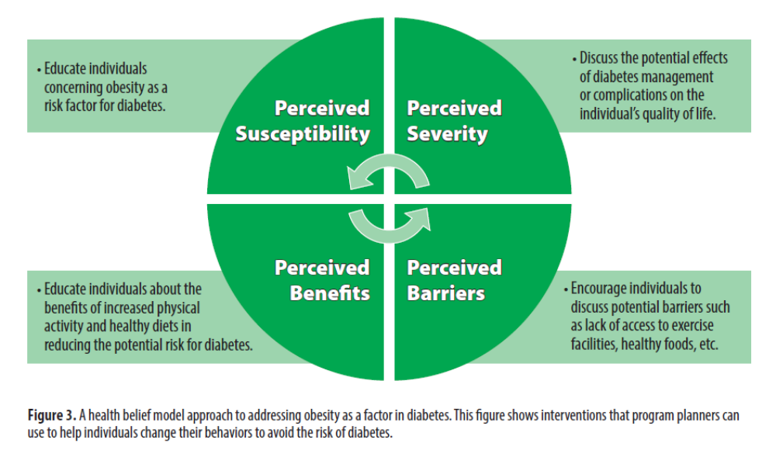

Health Belief Model
Likelihood of an individual taking action based on interaction between four types of belief:
Am I at risk?
Perceived threat
It is a serious problem
Making changes would help
Outcome expectancies
Changes are difficult
Cues to action
Self efficacy
Self-efficacy
(Simpson, 2015)

Slide 10
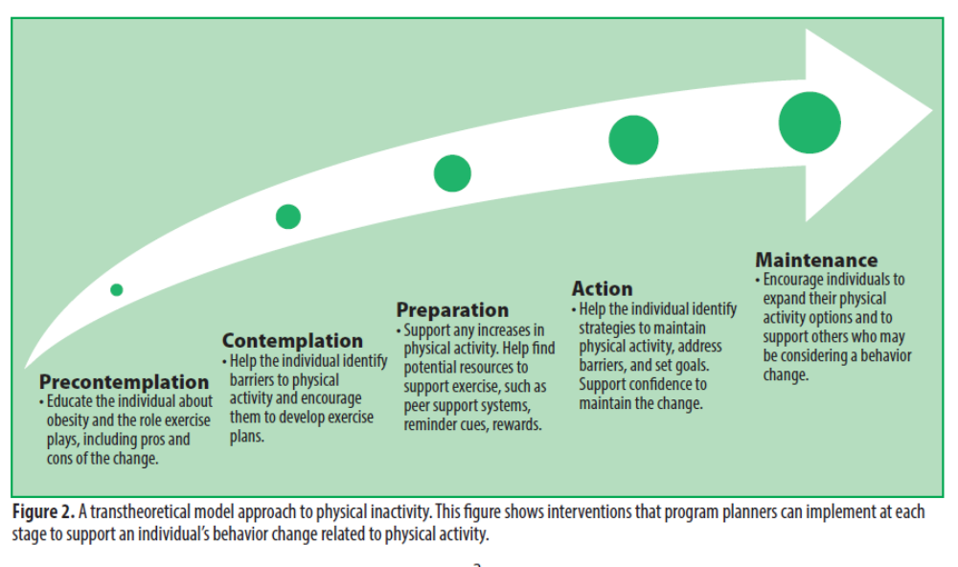
Stages of Change (transtheoretical) model
Journey, not the arrival
Different stages of readiness at different points?
Not linear
(Prochaska & DiClemente, 1984; Simpson, 2015)

Slide 11
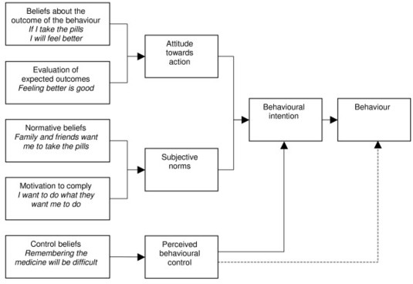
TRA
TPB
(Fishbein, 1967)

Slide 12
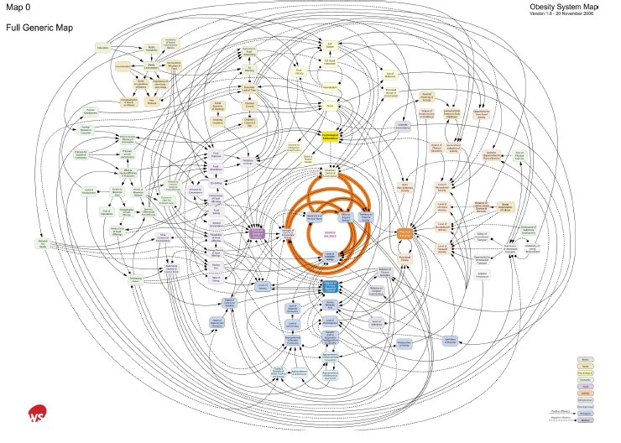
Very complex….
‘Inevitable & largely involuntary consequence’
(Butland et al, 2007: www.foresight.gov.uk)

Slide 13
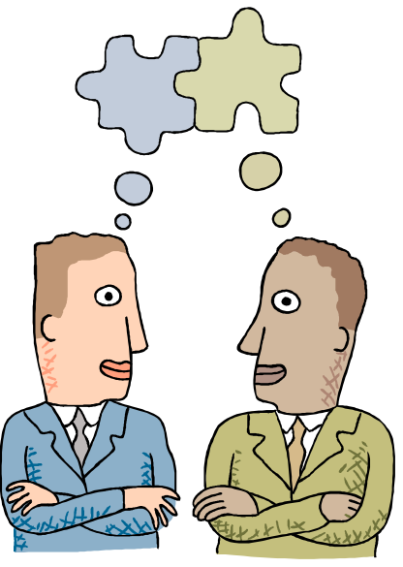
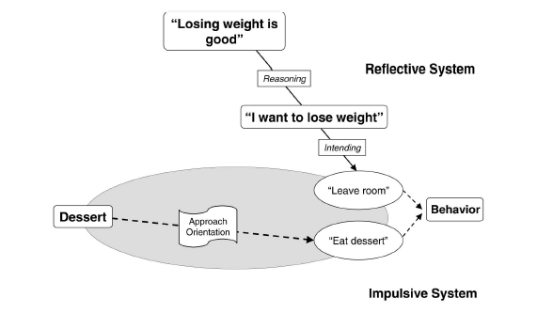
Are we rational decision makers?
Social factors:
Personal interaction
Within & between groups
Large scale social context
Physical environment
? Behaviour change and:
Emotional processes, transferability across culture, genes + environment & social factors, social dynamics
(Strack & Deutsch, 2004)

Slide 14
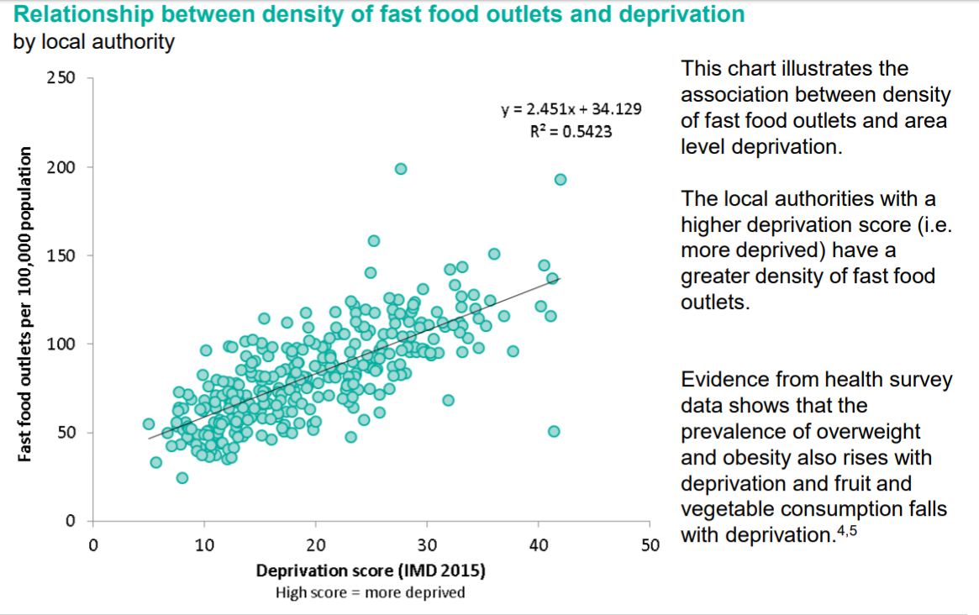
Ecological models & behaviour change
Environment affects health & vice versa
Modest changes may address multiple drivers of behaviour
Community input
(PHE, 2016)

Slide 15
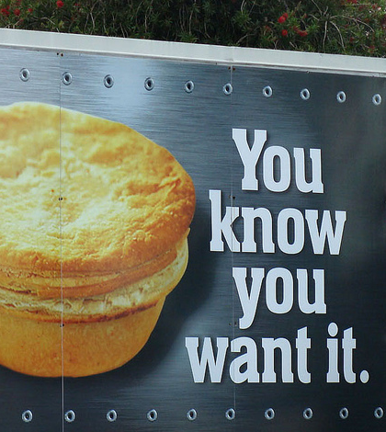

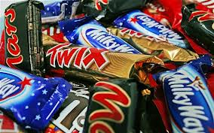
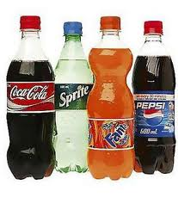
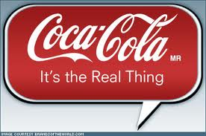
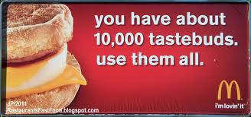
Gary Lineker rockets to new heights in New Walkers Crisps Stairlift TV ad (youtube.com)
(Boyland & Halford, 2013)

Slide 16
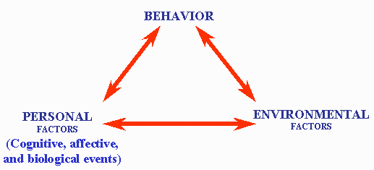
Interpersonal theories: Social Cognitive Theory
Conceptual Model
Source: Pajares (2002). Overview of social cognitive theory and of self-efficacy. 12-8-04.
From http://www.emory.edu/EDUCATION/mfp/eff.html.
Social & physical
Addresses underlying determinants of health behaviour and the methods of promoting change (Bandura, 1991)

Slide 17
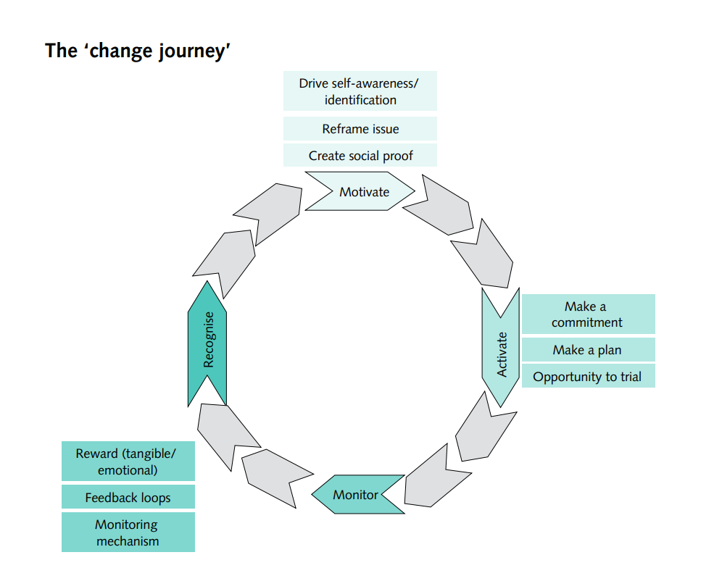
(DH, 2011)

Slide 18
Identifying key components & factors
Trying to lose weight; has tried hard to stop gaining weight over the years
Want to breastfeed; family think bottle is best
Build self-efficacy, self-regulation, outcome expectations & coping skills into HP interventions (Byrd Bredbenner et al, 2011)

Slide 19
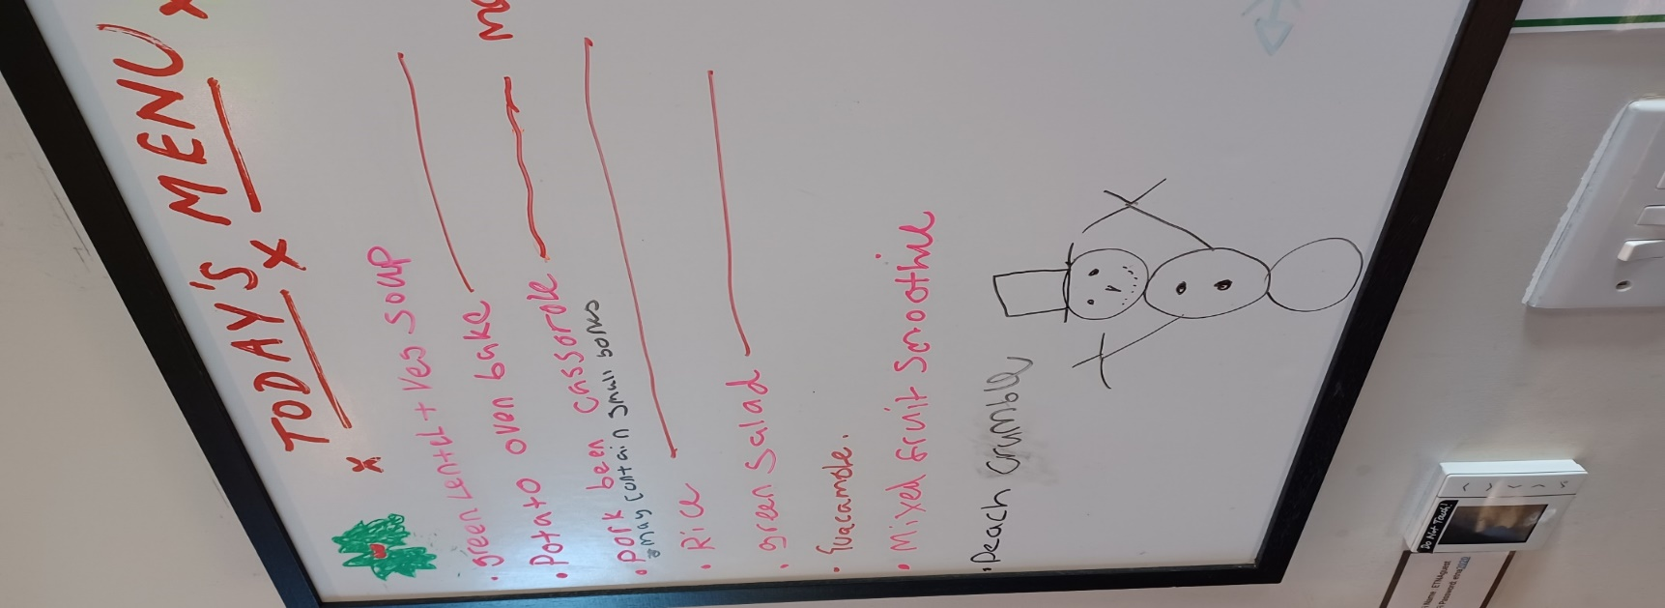
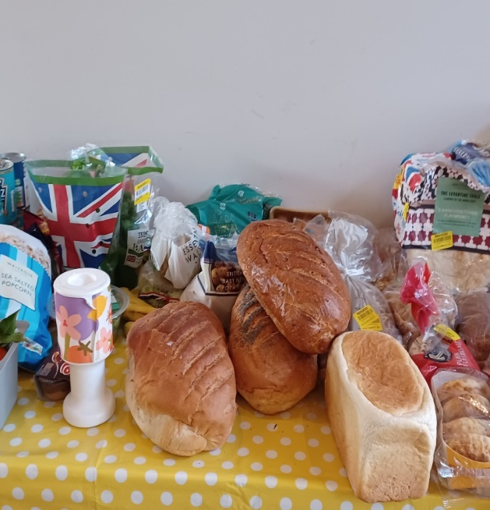
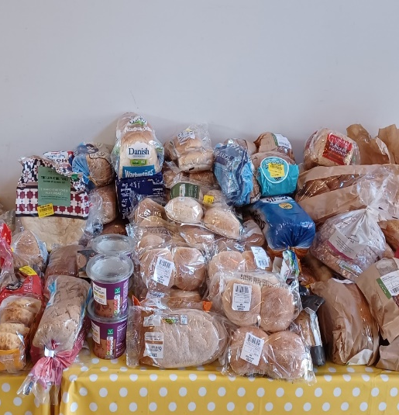
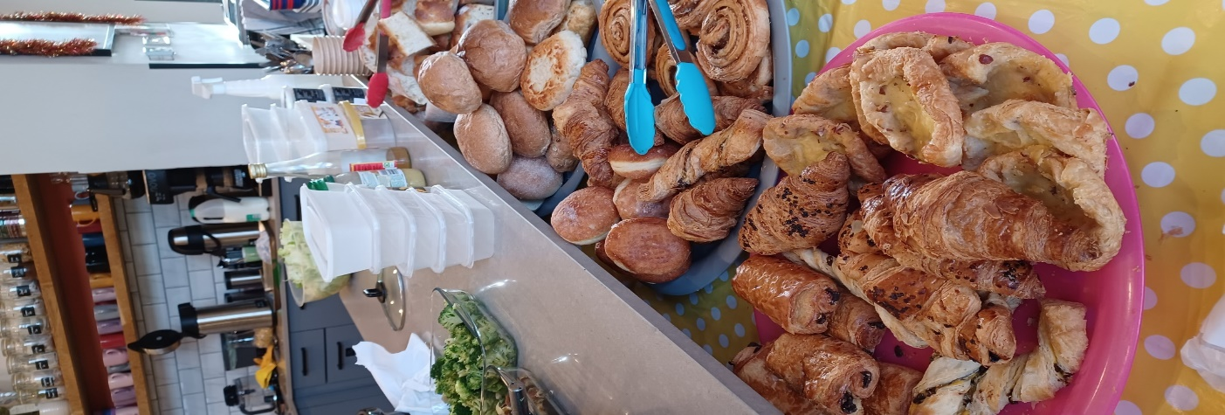
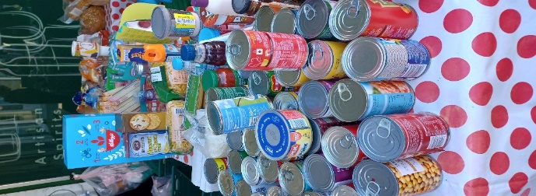
Community Organisation
Identify common problems, mobilise resources, develop & implement strategies to reach collective goals
Community identifies issues itself
Multiple levels of a health problem
Social networks & social support

Slide 20
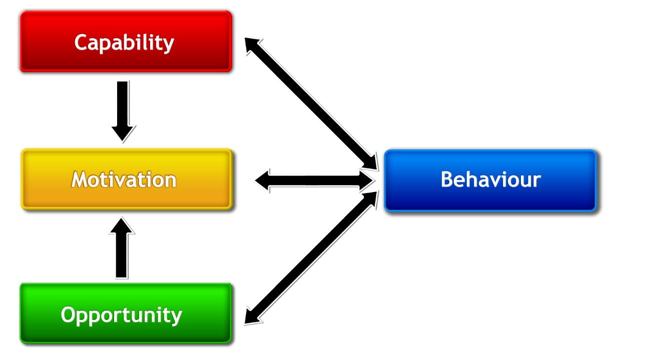
COM-B system for analysing behaviour in context
Capability, motivation & opportunity all need to be present for a behaviour to occur
Interact as part of a system
Motivation must be stronger for the target behaviour than competing behaviours
(Michie et al, 2011)

Slide 21
Stakeholder involvement
Scenario
Young people recognised as often having poor diets. University canteen sells many foods which are not nutritionally ideal & the university is surrounded by fast food outlets, popular with students.
Identification using TACT principle: Target; Action; Context; Timeframe
Who are the stakeholders?

Slide 22
‘‘to avert a public health crisis at the hands of chronic lifestyle-driven diseases, we need not only focus on changing individual behaviours, but also on changing the environments that give rise to those behaviours. Governments and employers must recognise the overwhelming influence of context on action, and take advantage of their unique position to intentionally shape environments that promote healthy behaviours’’

Slide 23
References
Bandura A (1991). Social cognitive theory of self-regulation. Organizational Behavior and Human Decision Processes 50(2): 248-287.
Boyland EJ & Halford JCG (2013). Television advertising and branding. Effects on eating behaviour and food preferences in children. Appetite 62: 236-241.
Butland B et al (2007). Tackling Obesities: Future Choices. Project Report. Foresight: London.
Byrd-Bredbenner C et al (2011). Relationship of social cognitive theory concepts to mothers’ dietary intake and BMI. Maternal and Child Nutrition 7: 241–252
DH (2011). Change4Life Three Year Social Marketing Strategy. https://assets.publishing.service.gov.uk/media/5a7baa68e5274a7318b9020a/dh_130488.pdf
Fishbein M (1967). Readings in attitude theory and measurement. Wiley.
Huber et al (2011). How should we define health? BMJ 343:d4163
Michie S et al (2011). The Behaviour Change Wheel: a new method for characterising and designing behaviour change interventions. Implementation Science 6: 42.
PHE (2016) Obesity and the environment. Density of fast food outlets. PHE: England.

Slide 24
Prochaska JO & DiClemente CC (1984). Self change processes, self efficacy and decisional balance across five stages of smoking cessation. Advances in Cancer Control - 1983. New York, NY, Alan R. Liss, Inc.: 131-140.
Simpson V (2015). Models and Theories to support Health Behavior Intervention and Program Planning. Purdue University: https://extension.purdue.edu/extmedia/HHS/HHS-792-W.pdf
Strack F & Deutsch R (2004). Reflective and Impulsive Determinants of Social Behaviour. Personality & Social Psychology Review 8(3): 220-247.
WHO (1948). WHO Constitution. https://www.who.int/about/accountability/governance/constitution
WHO (1986). Ottawa Charter for Health Promotion. https://www.who.int/teams/health-promotion/enhanced-wellbeing/first-global-conference
Winslow, C-EA (1920) The untilled fields of public health. Science 51: 23

